Slide 1


Slide 2

Presentation On
Prediction and Analysis Of Default Rate Future Loan
Presented By
Aishwarya Patil
Ayesha Shaikh
Pranav Botke
Imarticus Learning Institute, Pune

Slide 3
❖ Table of Content
Problem Statement
Introduction to Dataset
Pre-processing of Dataset
Exploratory Data Analysis
Feature Extraction
Selection of Model
Conclusion

Slide 4
❖ Problem Statement
To build a data model to predict the probability, of default, and choose the cut-off on based on what we feel suitable. Alternatively to use modelling technique which gives binary output based on the data that is available during loan application , building a model to predict default in the future. This will help the company in deciding whether or not to pass the loan.

Slide 5
❖ Understanding Dataset
These files contain complete loan data for all loans issued through the June 2007- Dec 2015, including the current loan status and latest payment information. The file containing loan data through the "present" contains complete loan data for all loans issued through the previous completed calendar quarter. Additional features include credit scores, number of finance inquiries, address including zip codes, and state, and collections among others. The file is a matrix of about 855969 observations and 73 variables

Slide 6
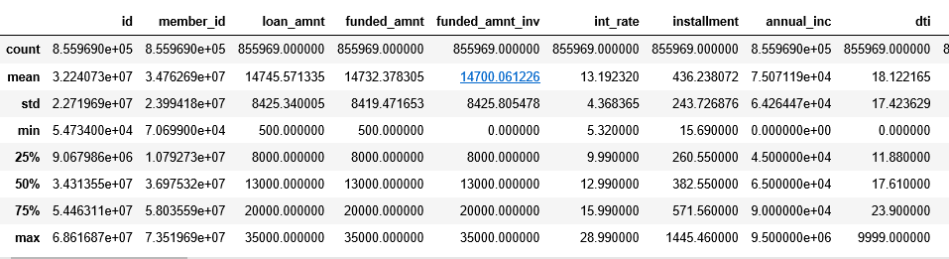
❖ Understanding Dataset
✓ Checking number of Columns and Rows
✓ Describe the Dataset
(855969, 73)

Slide 7

❖ Pre-Processing of Dataset
✓ Checking NA’s, NULL’s, ?, BLANKS
✓ Dealing with missing values
✓ Dropping Unnecessary Columns
Checked for Nulls and Blanks in the dataset
Columns having missing values greater than 80% have been dropped

Slide 8
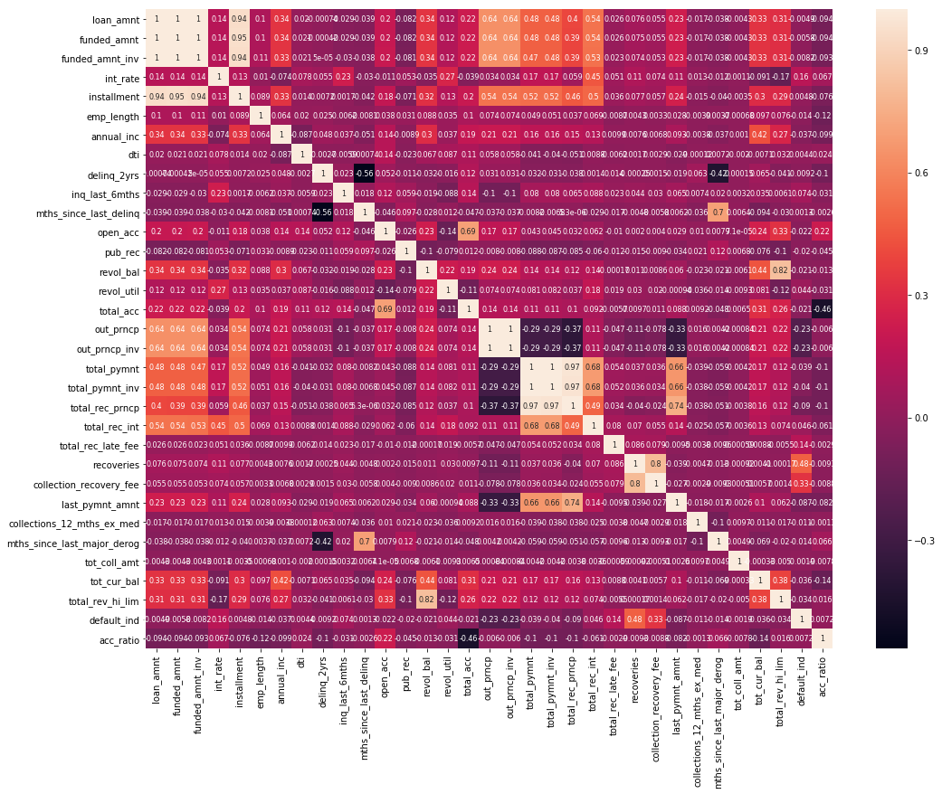
❖ Graphical Representation
1. Correlation between the features

Slide 9
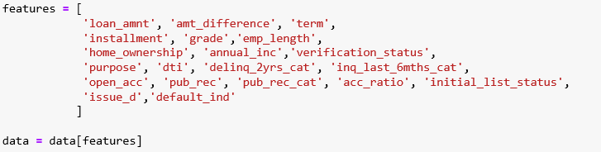
❖ Exploratory Data Analysis
✓ Finding the correlation between the variables
✓ Selecting important variables
It can be seen from the plot above that loan amount and installment have a very high correlation
amongst each other (0.94). This is intuitive since a person who takes a large sum of loan would
require extra time to repay it back. Also, interest rate, sub grade and grade have a very high
correlation between them. This is obvious since interest rate is decided by grades once the
grades are decided, a subgrade is assigned to that loan (leading to high correlation).

Slide 10
❖ Exploratory Data Analysis
✓ Transformation
Splitting Dataset into Training and Testing
✓ Model Selection
Before training the data, we would first transform the data to account for any skewness in the variable distribution.(Float)
We split the dataset based on ‘issue_d’
Train set - (June 2007 - May 2015)
Test set – (June 2015 – Dec 2015)
1. Logistic Regression
2. Random Forest

Slide 11




Results
✓ Accuracy
UNBALANCED
BALANCED

Slide 12
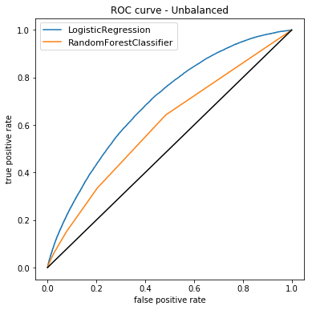
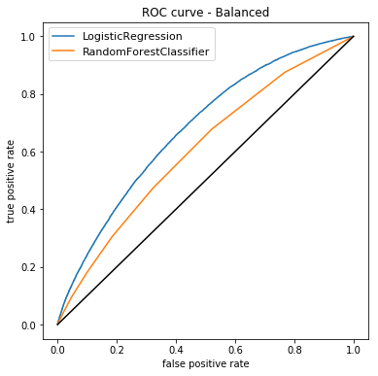
Results
✓ ROC Curve
UNBALANCED BALANCED

Slide 13


